Slide 1
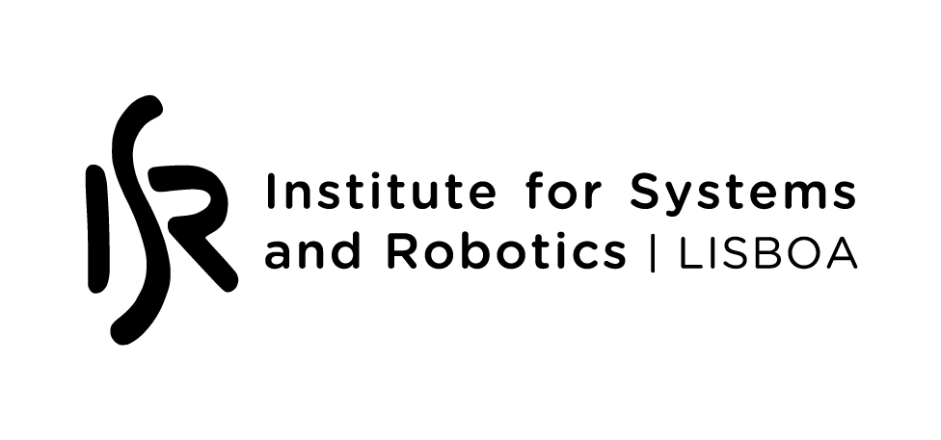
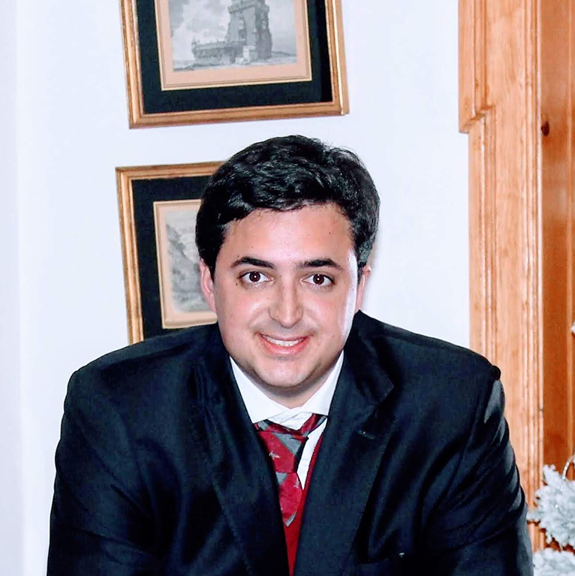
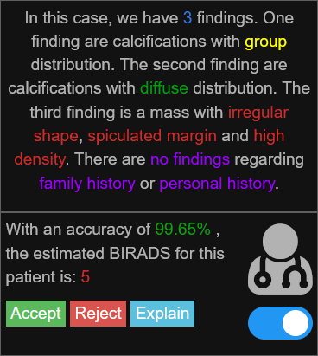
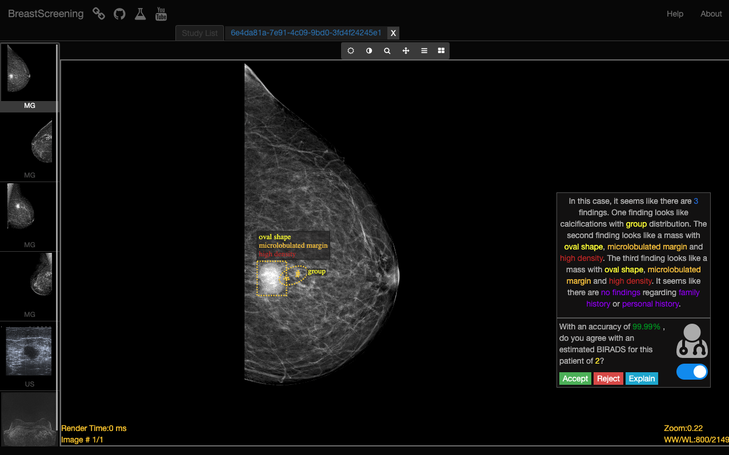
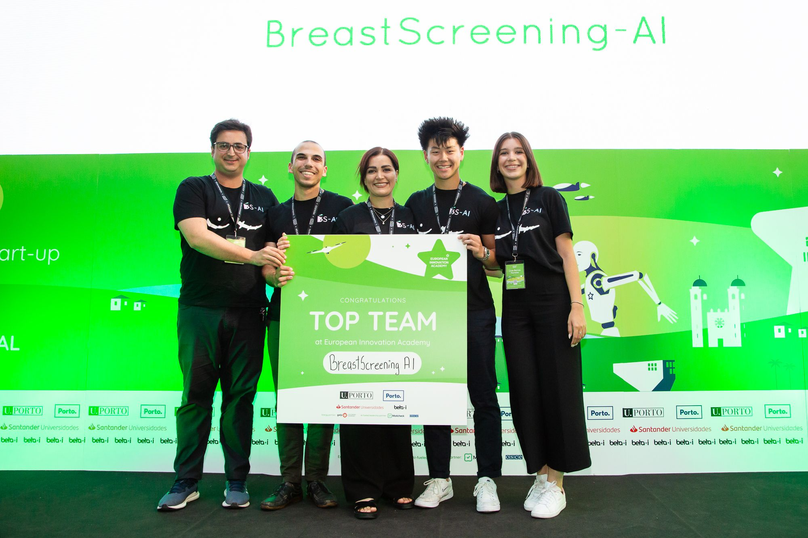
Research Highlights
Francisco Maria Calisto
Developed as a spinoff from IST with the support of ISR-Lisboa, the BreastScreening-AI project uses AI to enhance breast cancer diagnosis through medical imaging. We integrate AI effectively to boost clinician trust and decision-making, improving diagnostic speed and accuracy. This technology streamlines clinical workflows and enhances patient outcomes.
Post-Doctoral Researcher Human-Computer Interaction

